Slide 1


An Apparatus for the
Experimental Simulation of the Effects of Wind Transport on Martian Sands
Evolution | Testing | Use-case
Rachel Fry¹
Mentors: Dr. Devon Burr², Anna Baker²
Northern Arizona University
¹Applied Physics and Materials Science
²Department of Astronomy and Planetary Science

Slide 2

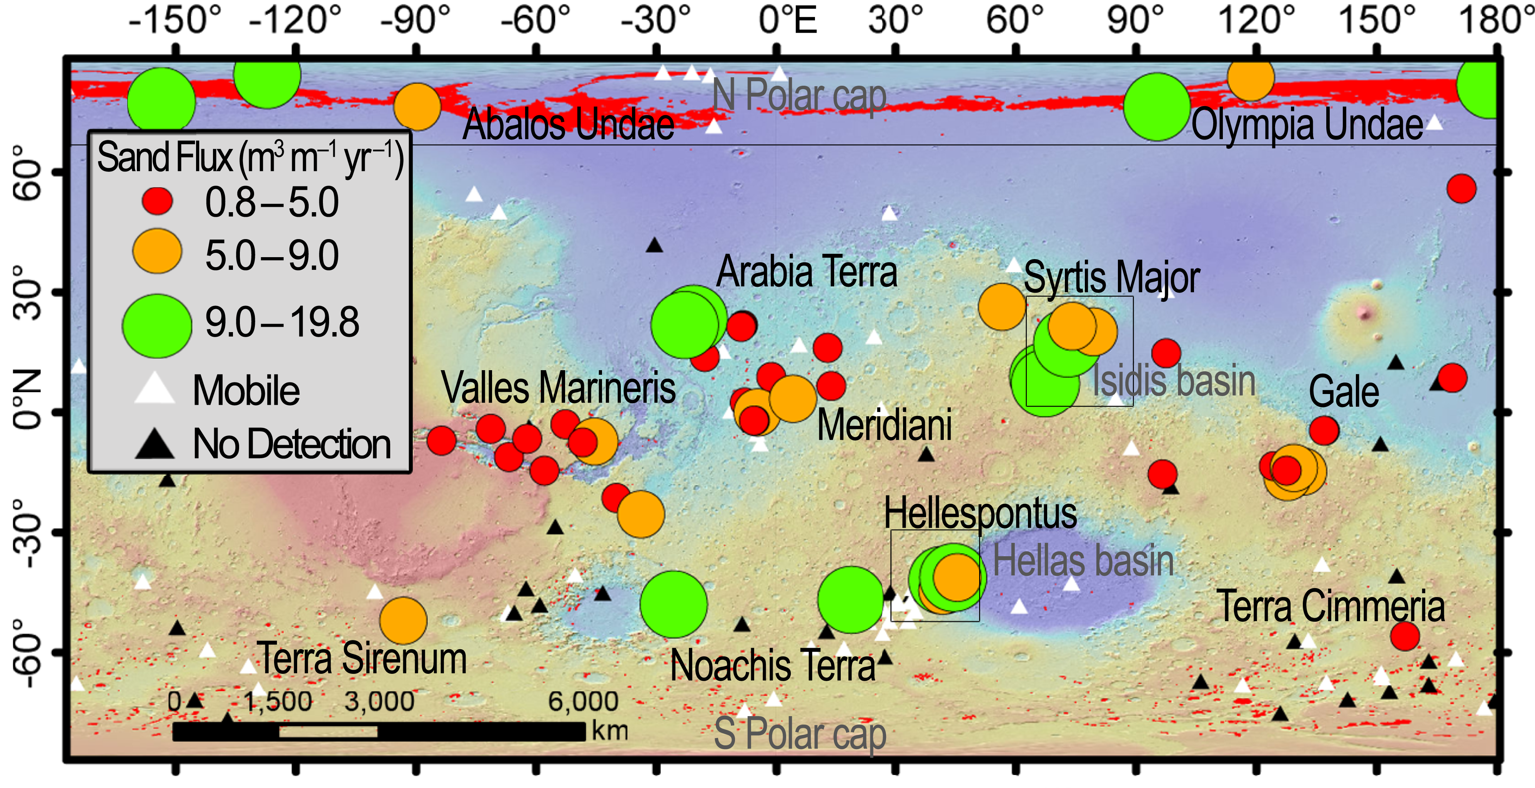
Background
Sand
Widespread on Mars
Movement driven by wind
Breaks down as it is transported
How can we simulate transport?
Air-driven mill
Mars-analogue sand
For what purpose?
Characterize evolution over time
Survivability
Determine sources and pathways
Global trends in bed-form mobility (Chojnacki et al. 2019)
NASA/JPL-Caltech/UofA, 2009

Slide 3
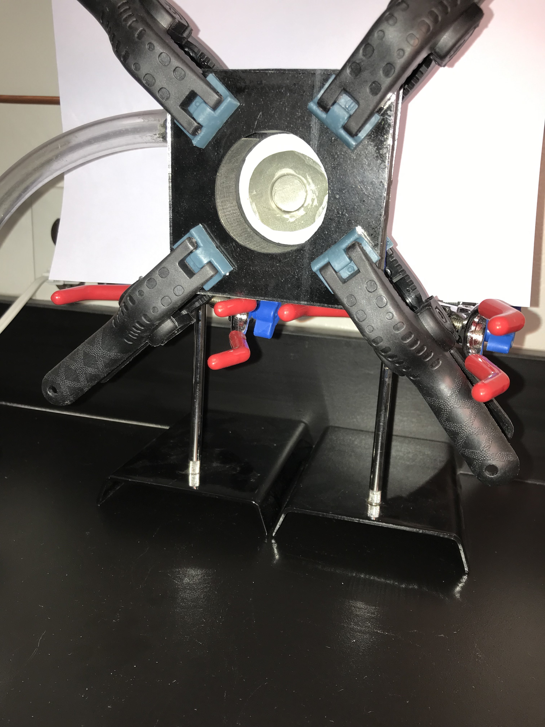
We created a mill to simulate Wind Transport
Mill configuration
Silicon carbide and epoxy body
Abrasion chamber
Glass plates
Mesh-covered air exit
Gaskets between mill and plates
Slotted air inlet
Experimental Setup
Airline secured to mill
Plates secured to body with clamps
Mounted for variable orientation
Notes:
Assertion (title - question) – evidence (supporting text)
Transition from previous slide

Slide 4
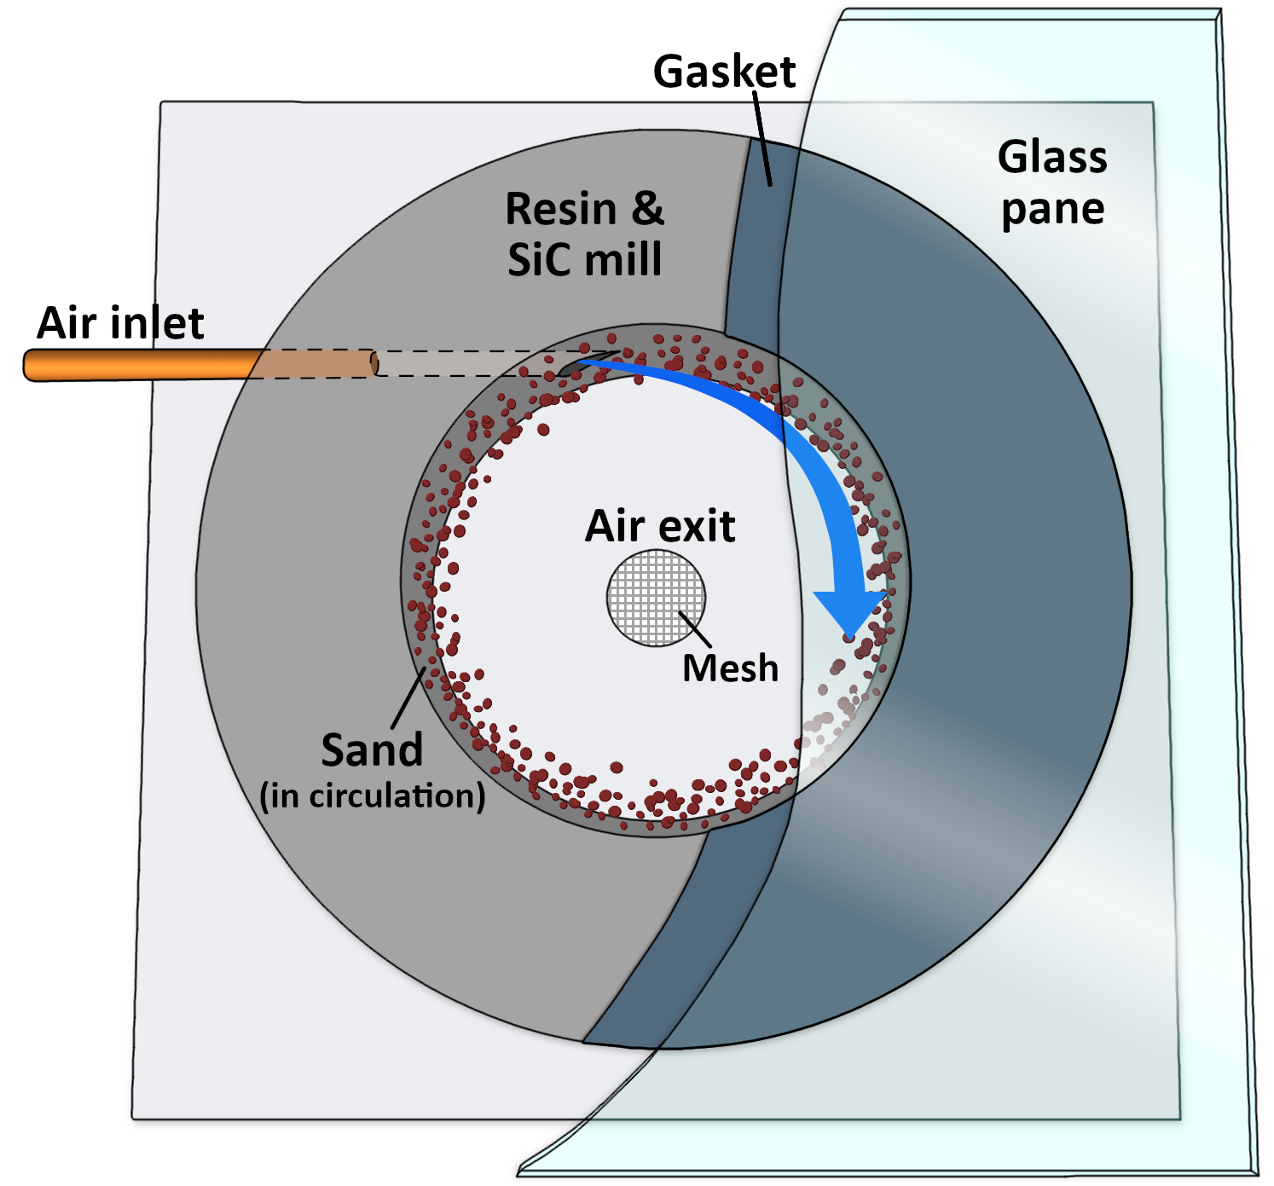
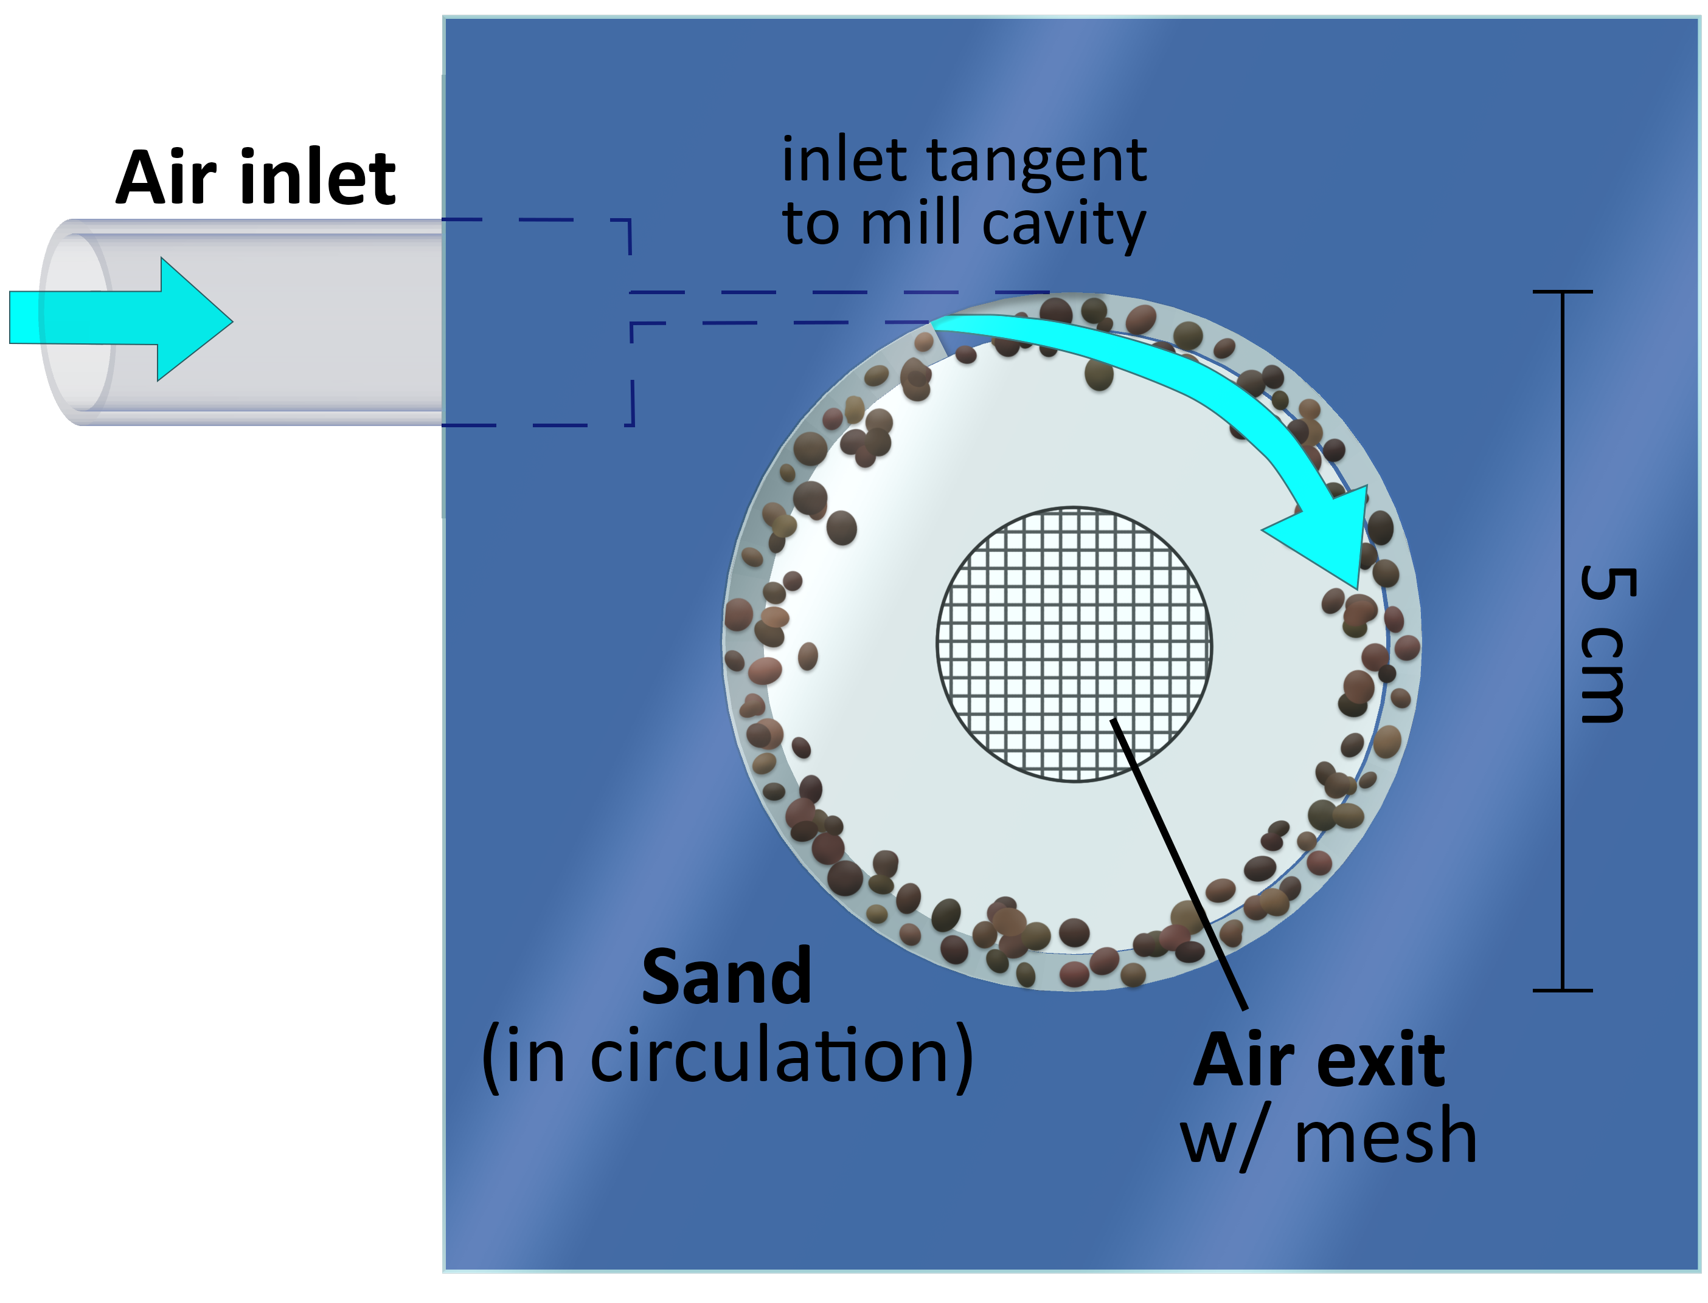
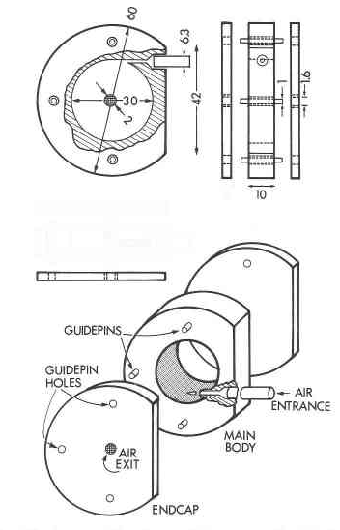
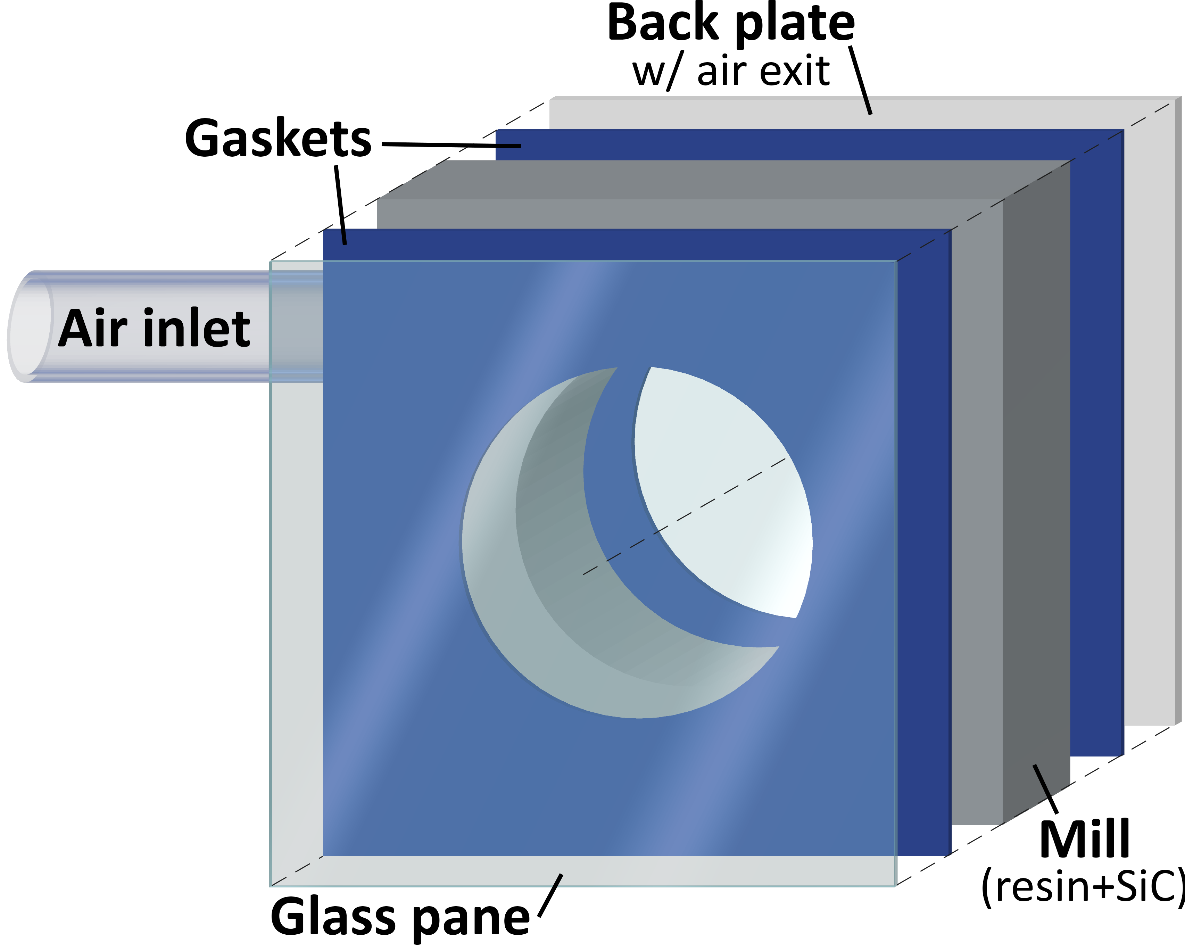
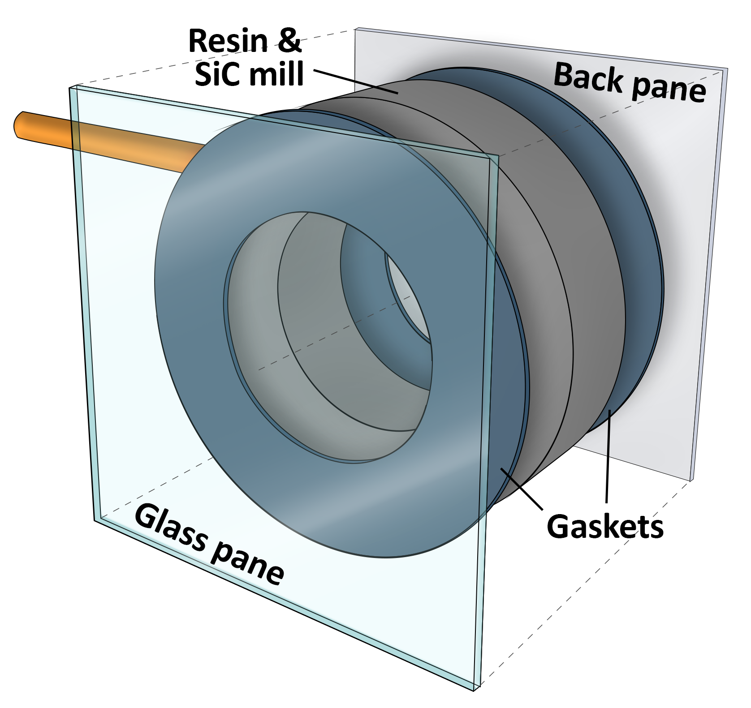
Our design evolved over time
Base Design¹
Initial Design²
Final Design²
Image credit: ¹Nitkiewicz and Sterner, ²Anna Baker
Notes:
Assertion title (Our design evolved over time)
Image captions get lost – box/shaded something
Design evolution included testing a variety of gasket and panel materials, chamber volumes, air exit diameters, air inlet diameters and shape, and mill shape. All changes were made to reduce a source of error seen during testing.

Slide 5
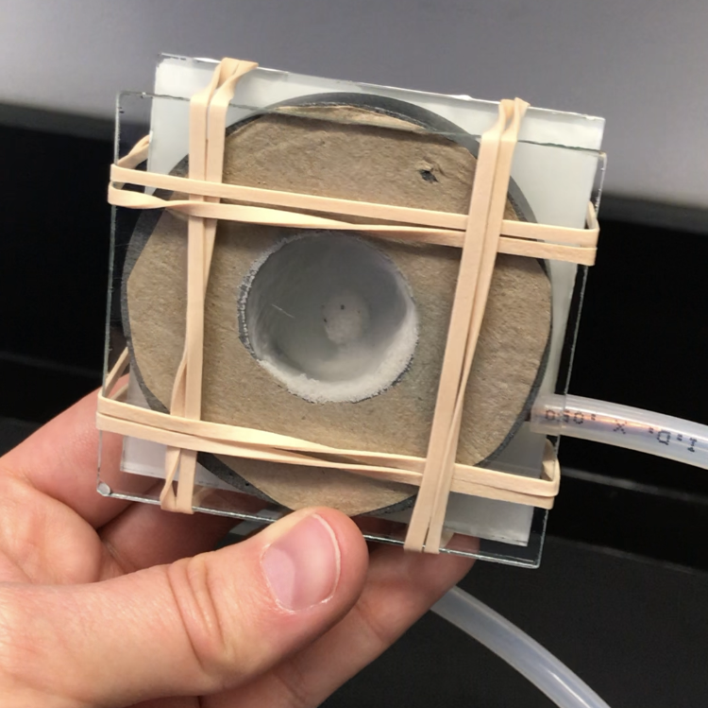
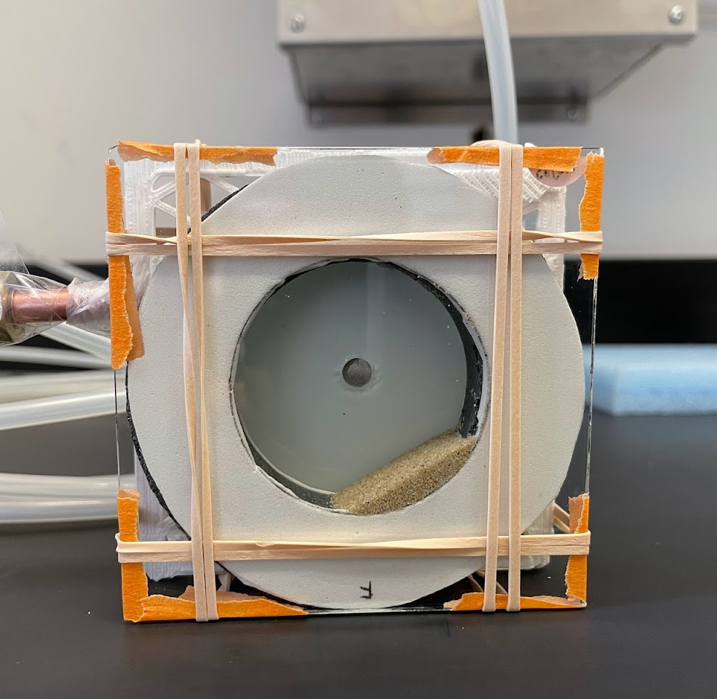
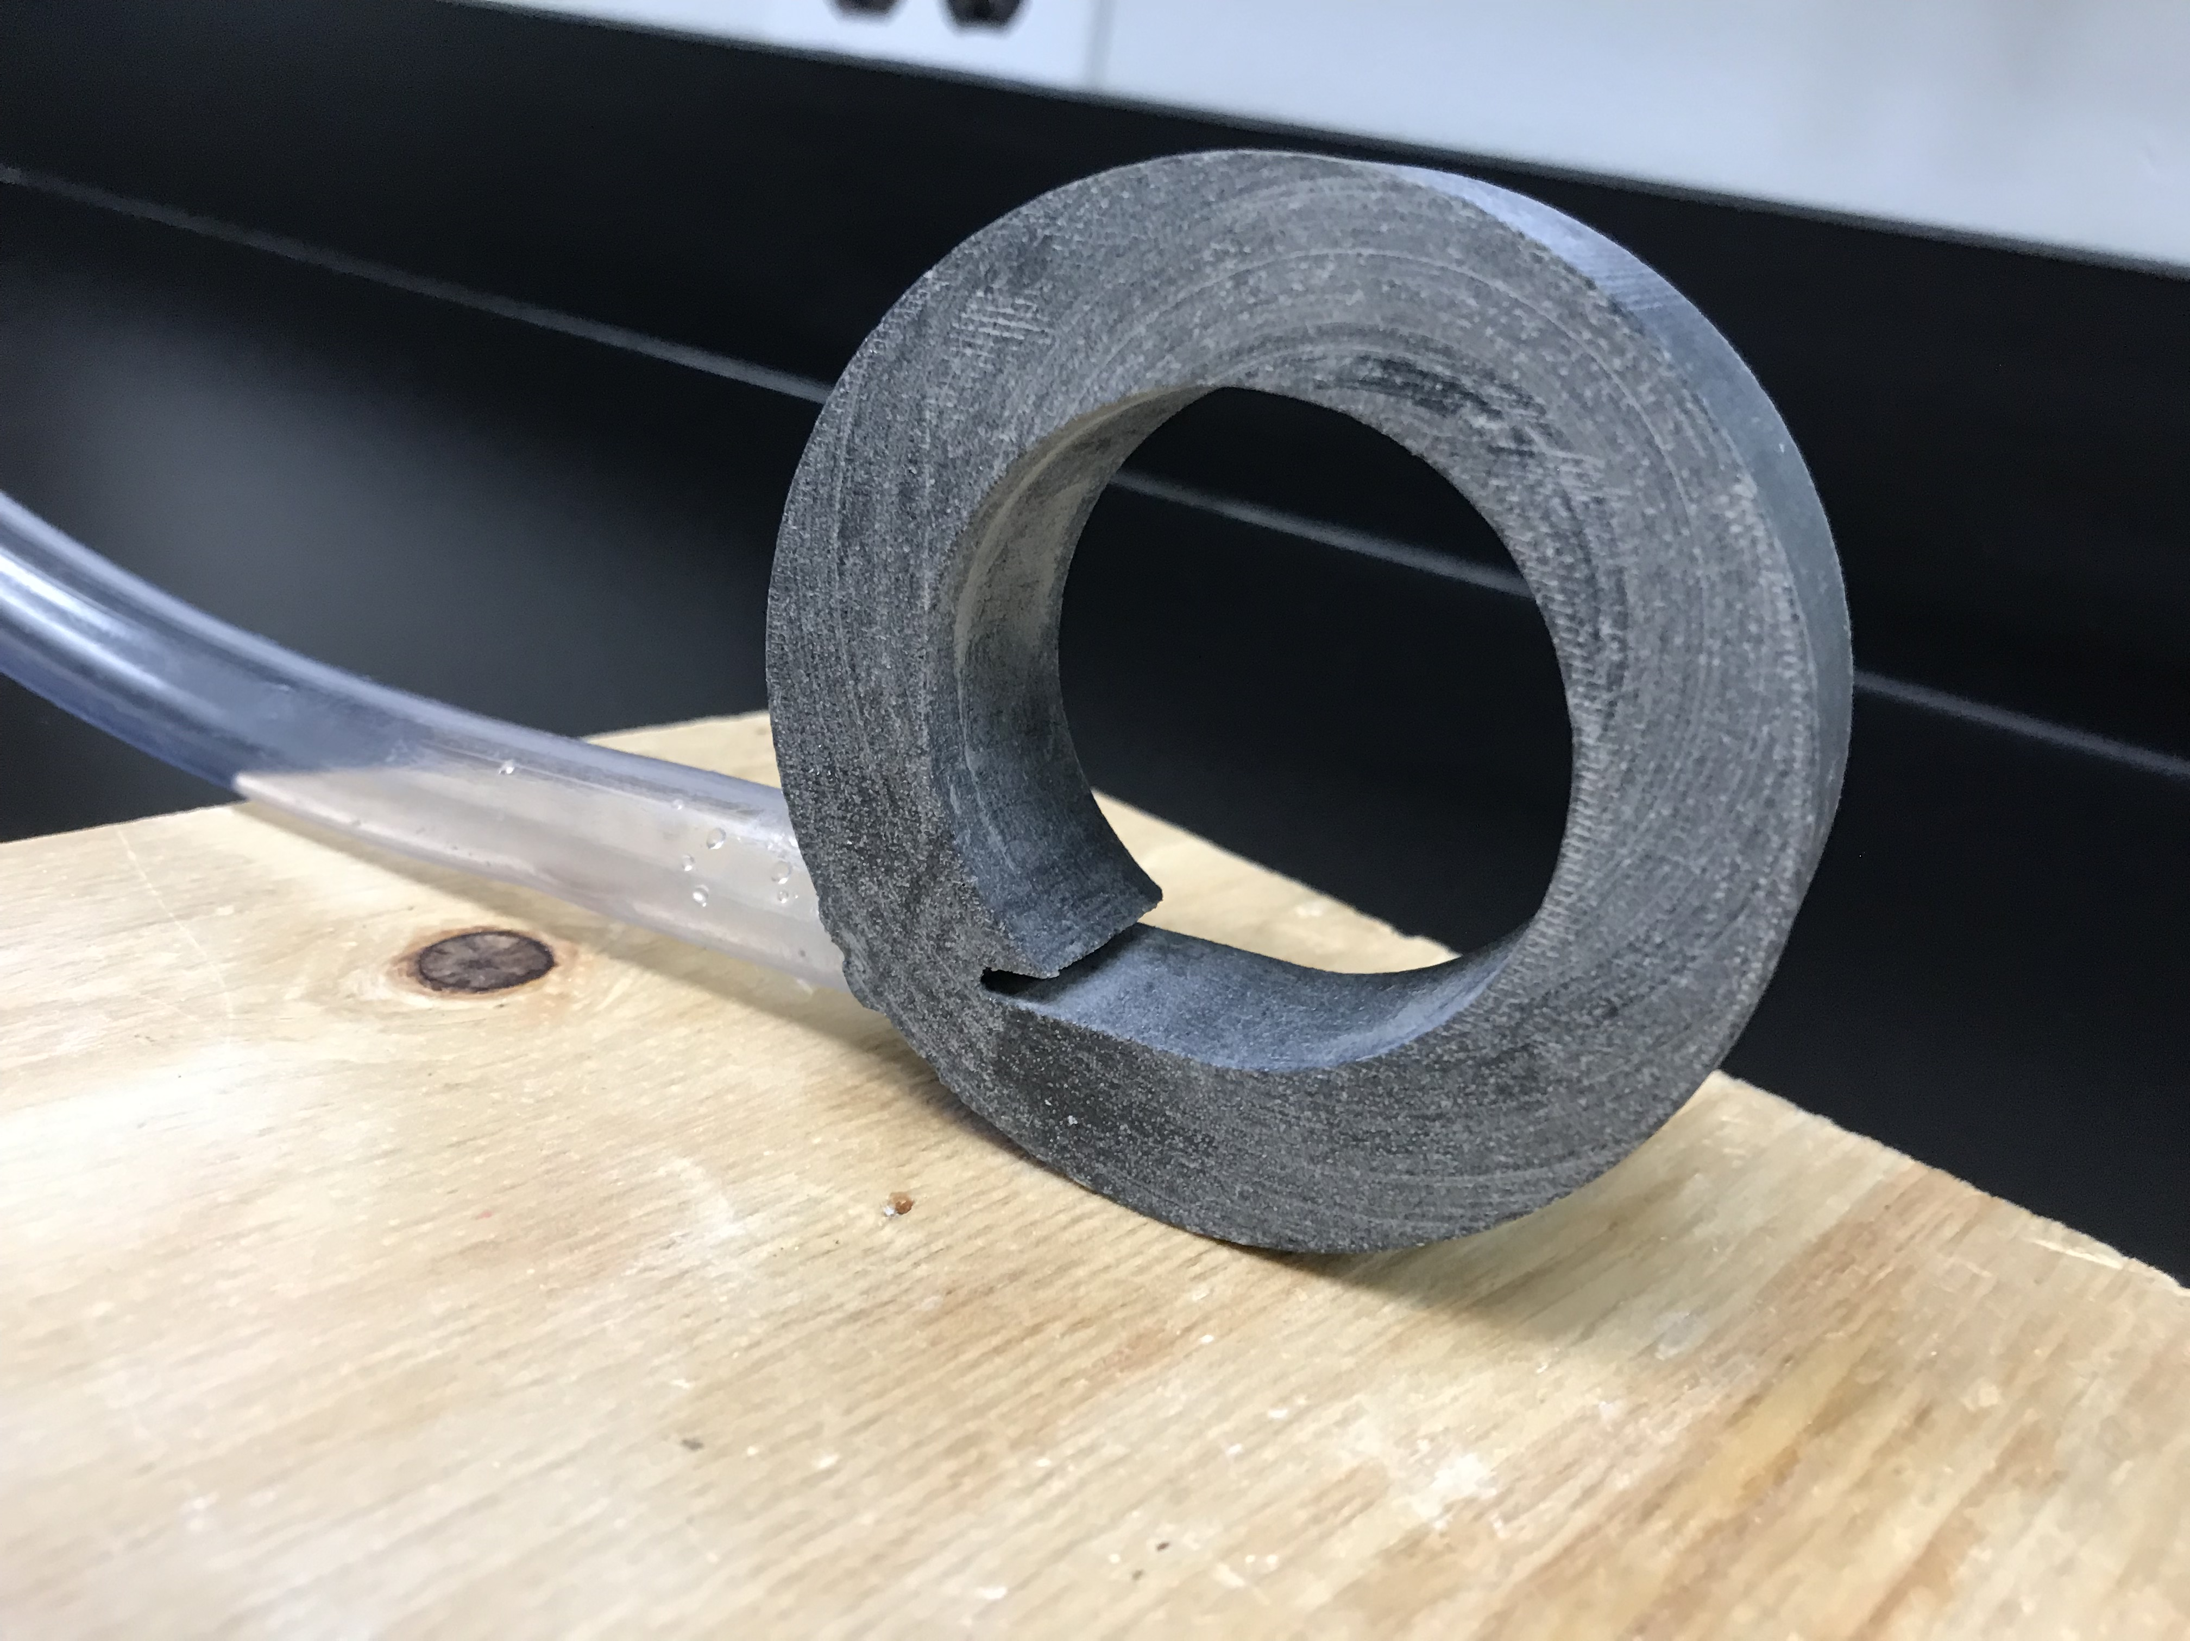
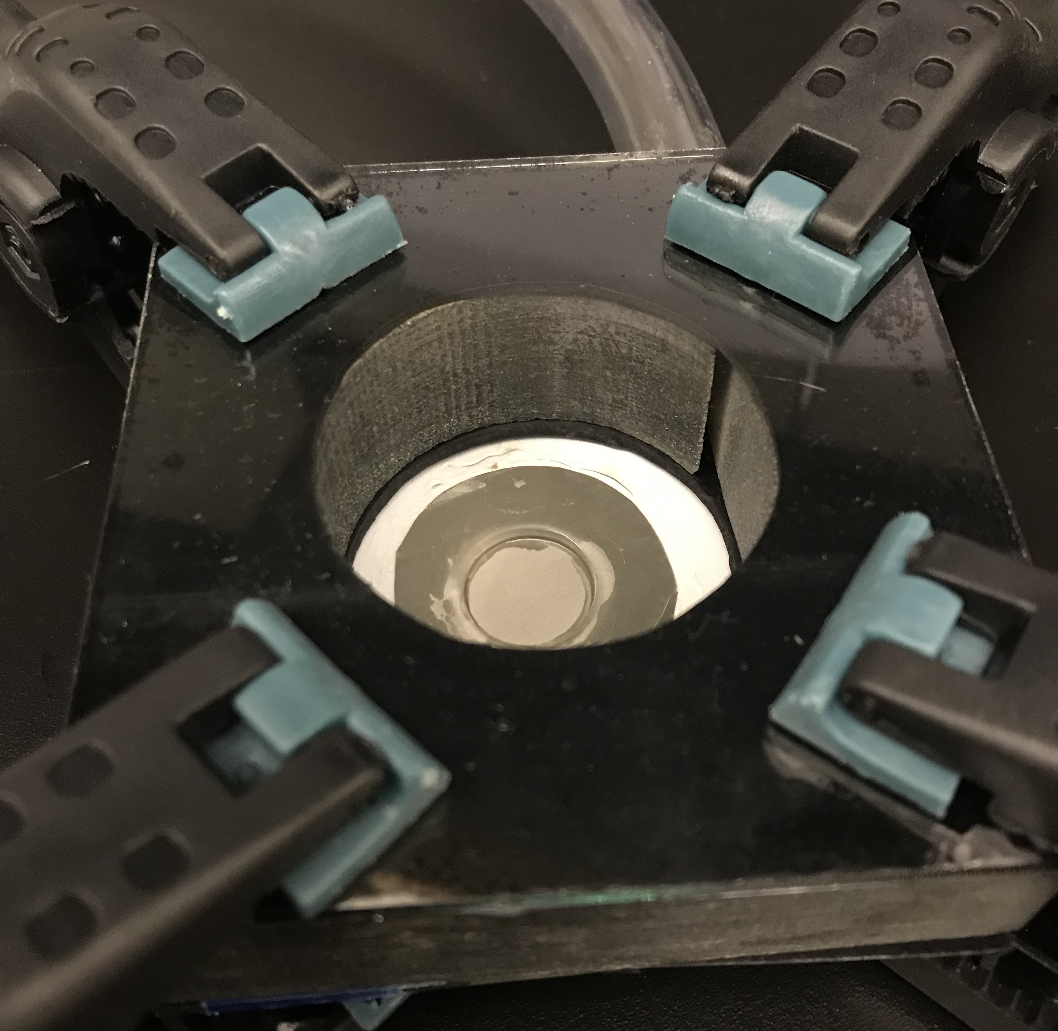
And in a number of ways
Inner chamber volume
Diameter of air inlet and exit holes
Gasket materials
Connections to airline
Shape of air inlet
Mill shape
Method of securing configuration
Front and back plate materials

Slide 6
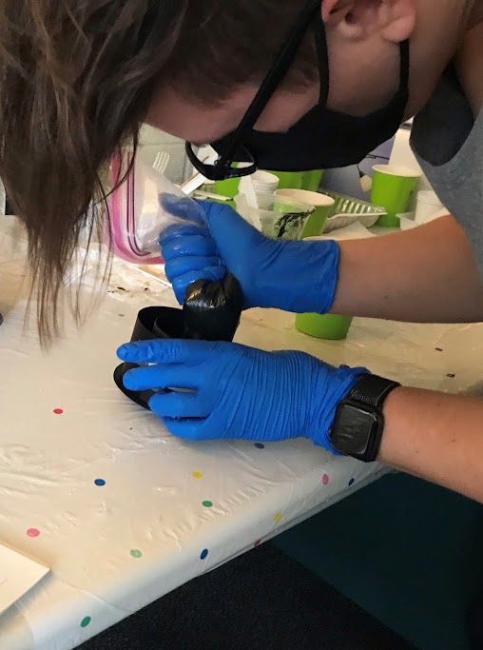
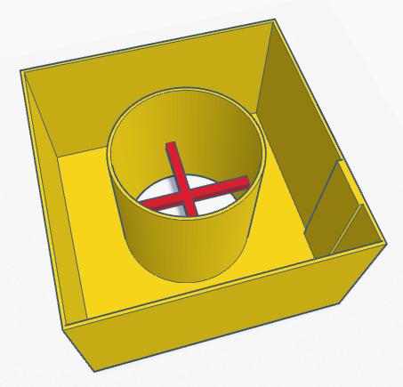
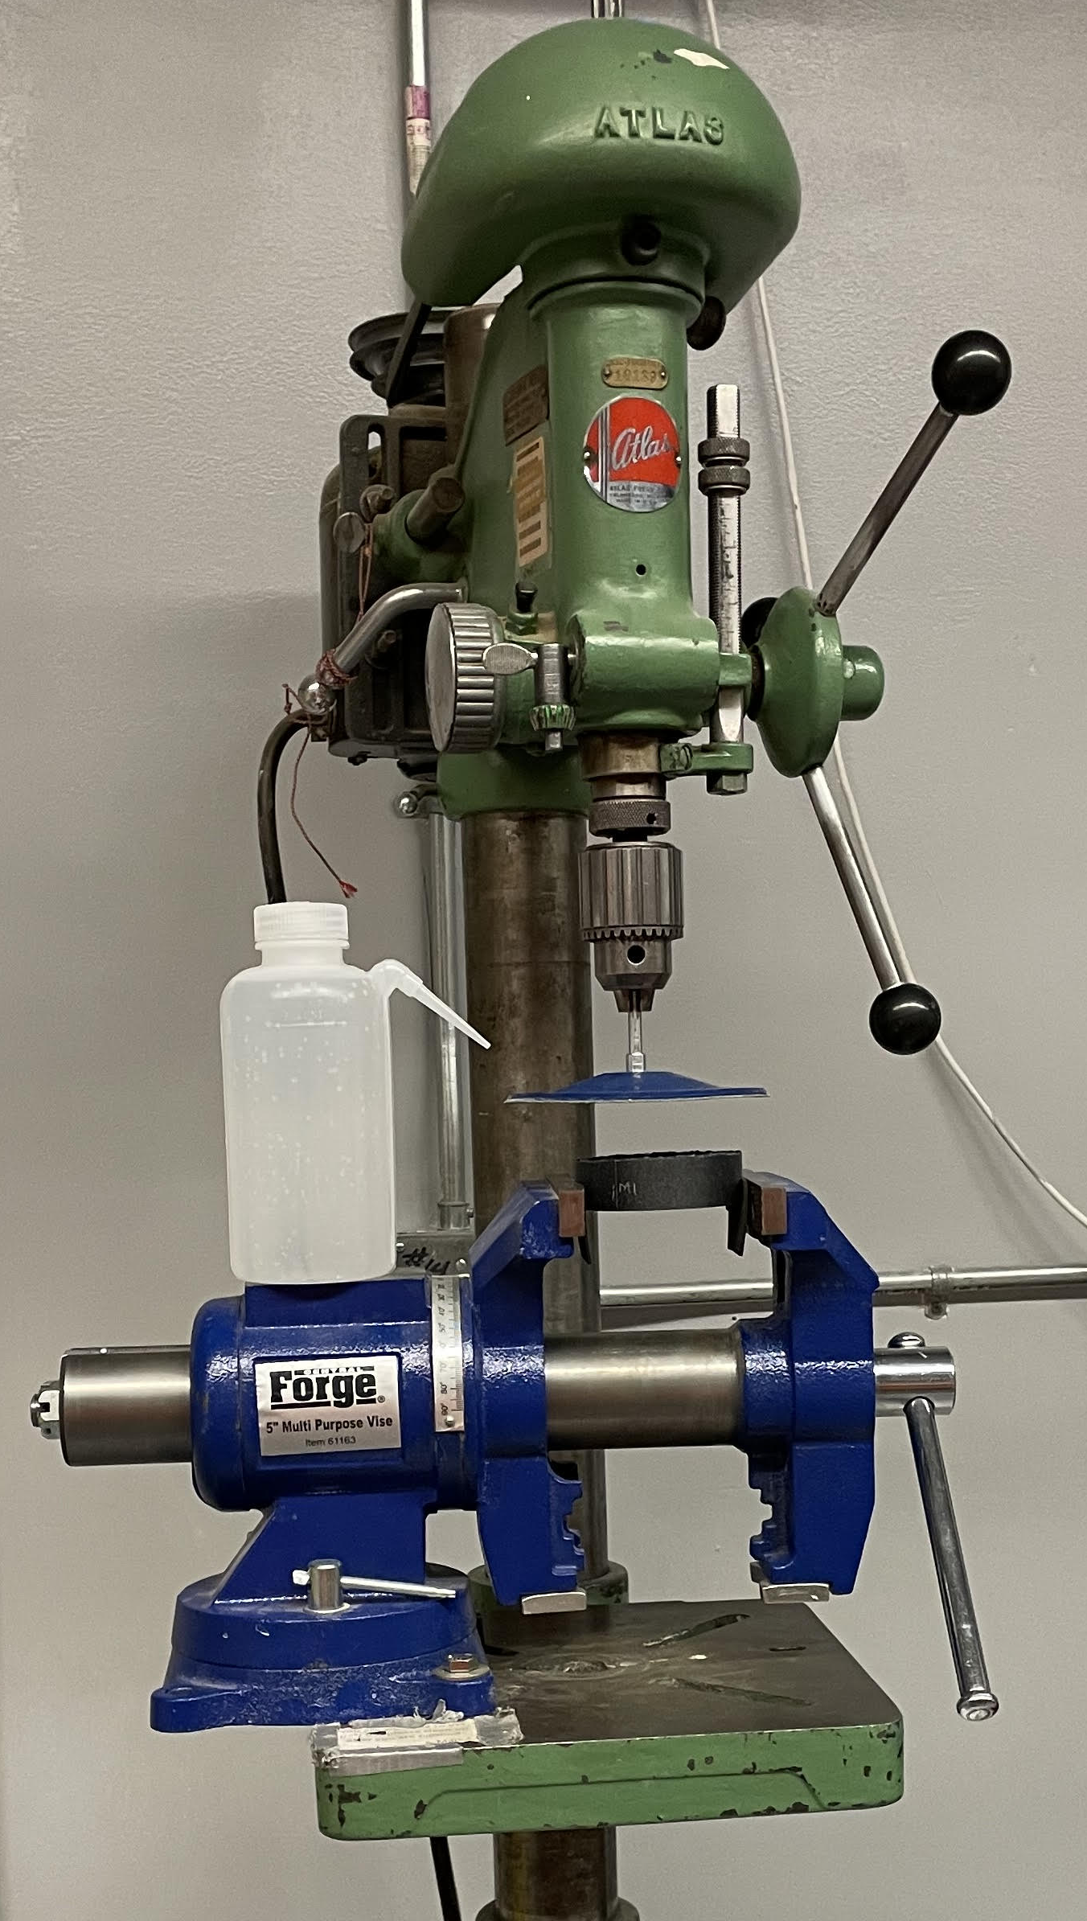
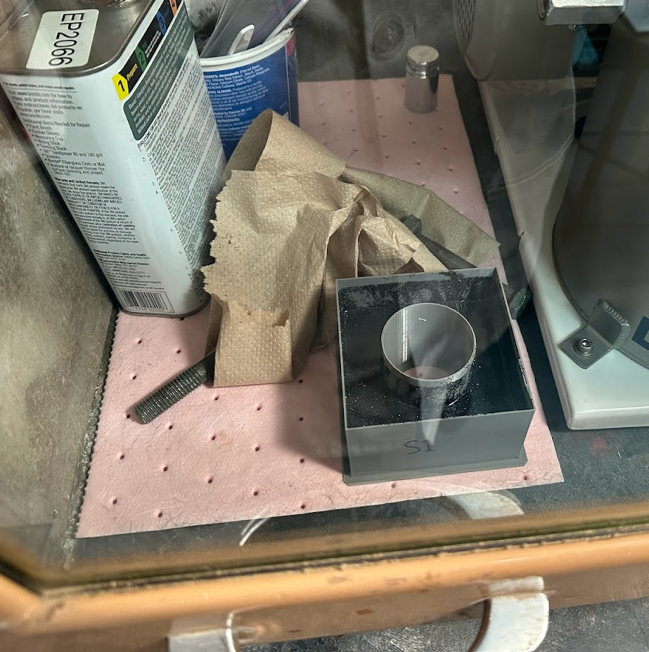
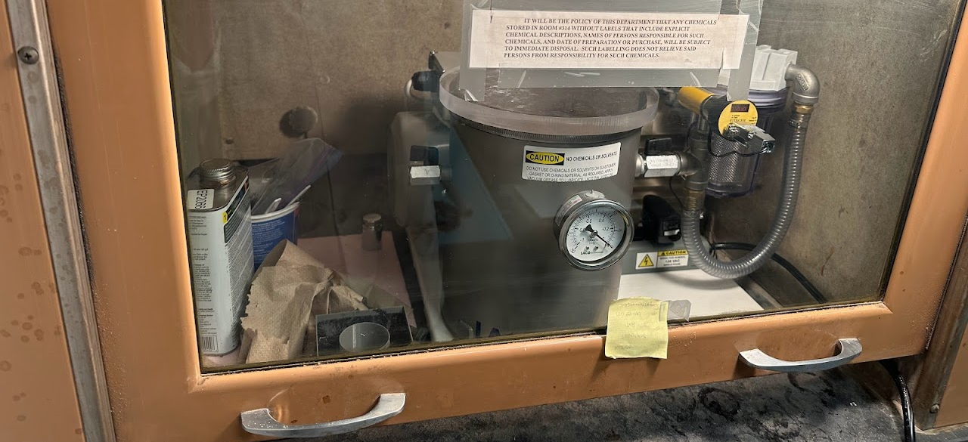
Building the Mill
Measure and mix epoxy-grit slurry
Deposit slurry into mold
Degas slurry using vacuum chamber
Remove mill from mold once dry
Sand front and back surfaces

Slide 7
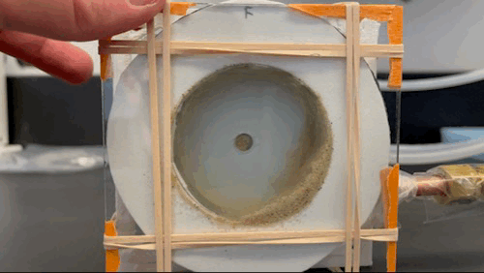
Testing the Mill

Slide 8
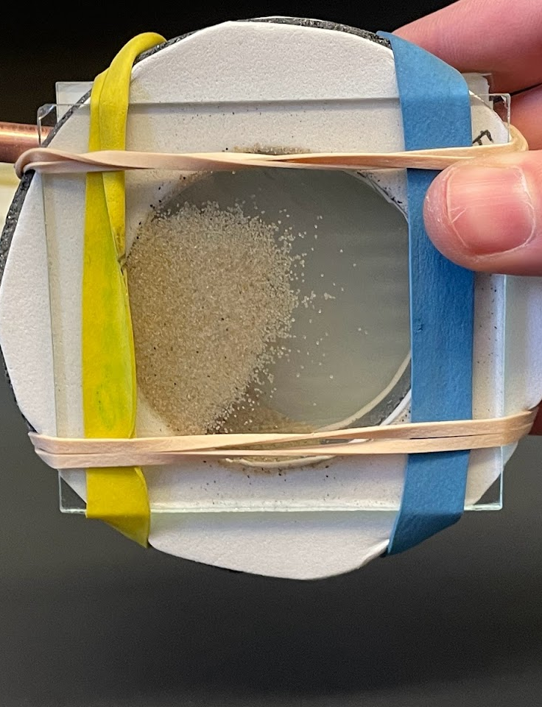
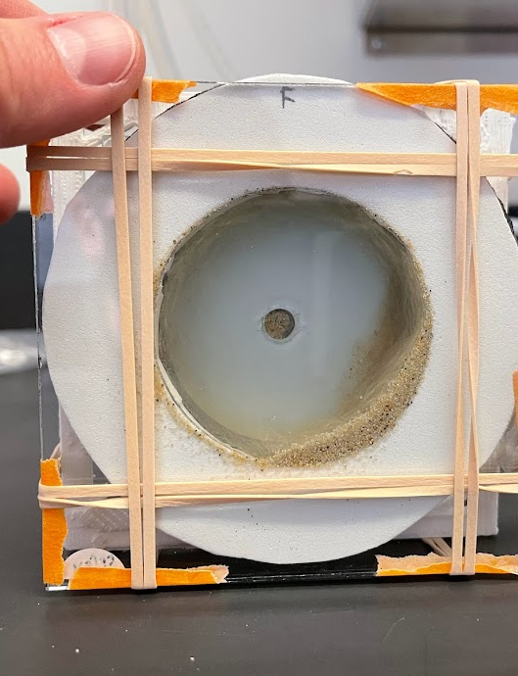
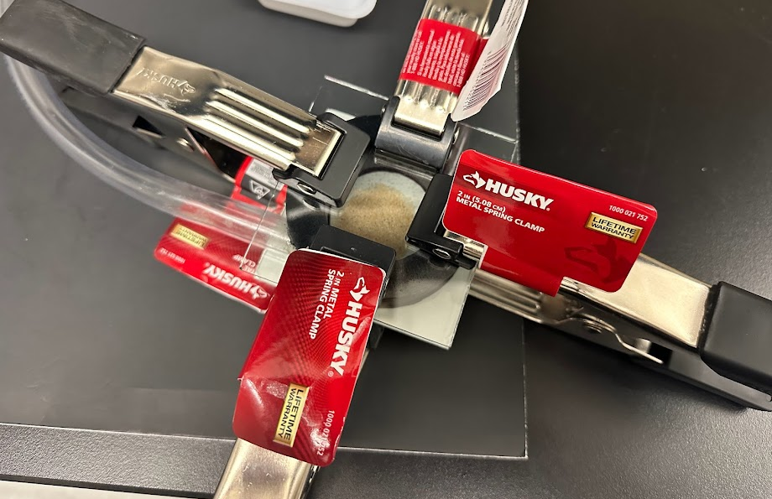
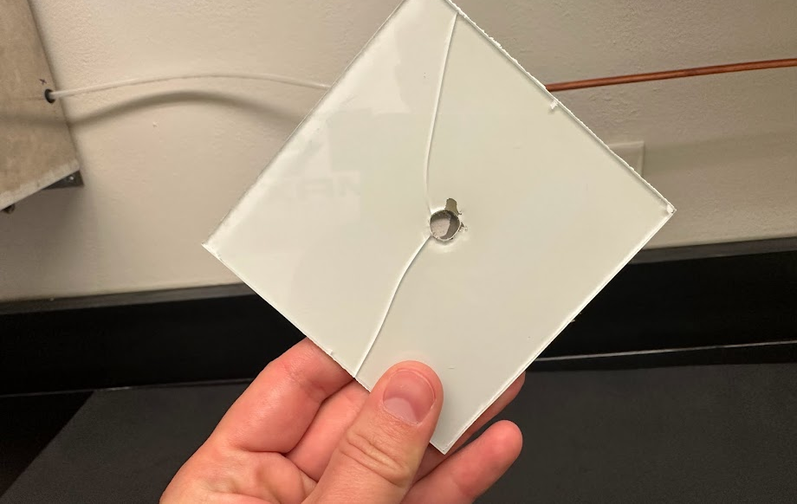
Common Issues
Unstable setup
Static buildup of grains on front plate
Non-circulating grains
Broken plates

Slide 9

Next Steps
Determine percentage of non-circulating grains
Run trials and analyze samples to determine best method and strength of circulation
Begin formal trials to characterize the evolution of Mars-analogue sand
Thank you: Devon Burr, Anna Baker, Paloma Rose Davidson, Arizona Space Grant Consortium, Northern Arizona University, Arizona State University, and NASA

Slide 10
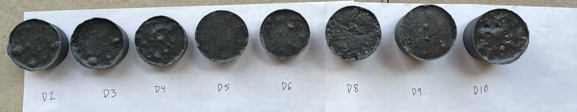
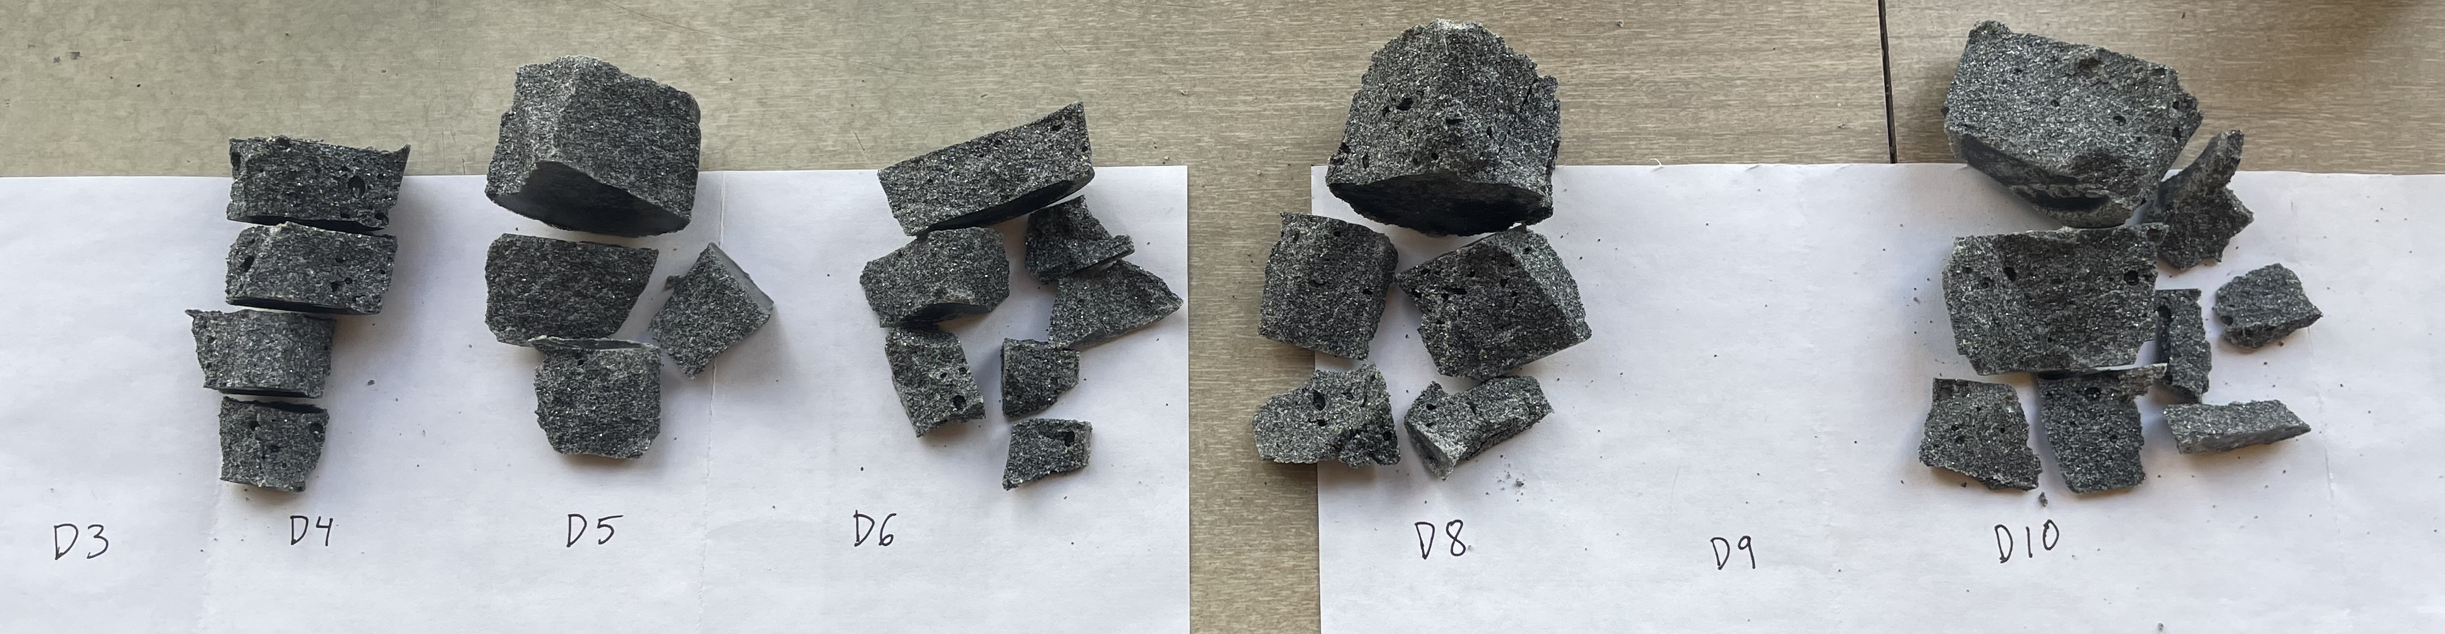
Technique progression
Tested various ratios of SiC-epoxy, technique for mixing and degassing slurry
Ratios: Texture
Maximum roughness while maintaining cohesion
Degassing technique:
Minimize air pockets
Uniform texture
Notes:
Supplemental slide – testing ratios and methods

